Slide 1
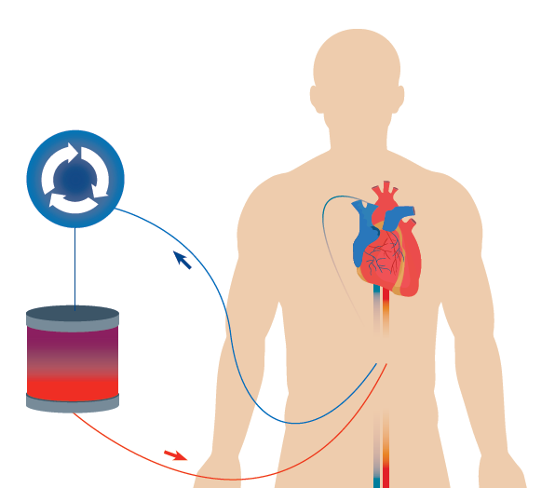
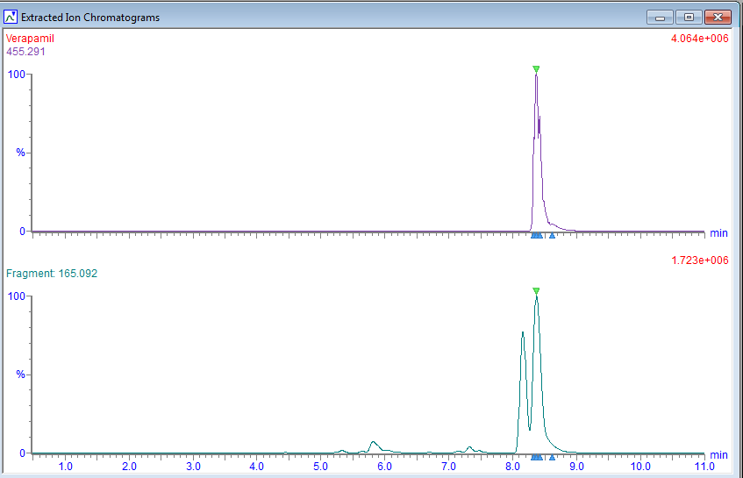

Survival following large verapamil overdose after use of extracorporeal membrane oxygenation (ECMO)
Jagpal PS,¹ Elamin MEMO,¹ Pucci M,² Ford L,³ Jones D,⁴ Thomas SHL,⁴ Bradberry SM.¹
¹ National Poisons Information Service: Birmingham Unit, Birmingham, UK;
² Queen Elizabeth Hospital, Birmingham, UK;
³ Department of Biochemistry and Toxicology, City Hospital, Birmingham, UK;
⁴ National Poisons Information Service: Newcastle Unit, Newcastle, UK
Introduction
‘Extracorporeal membrane oxygenation (ECMO) has been considered a good salvage therapy for patients with refractory circulatory shock as a consequence of poisoning’¹, Figure 1.
Objective
We describe a 17-year-old man who survived an intentional large overdose of verapamil but developed adverse effects following institution of ECMO.
Case Report
A 17-year-old male presented to hospital with bradycardia (52 bpm), confusion and drowsiness (GCS 13) following an out of hospital tonic-clonic seizure.
Initial arterial blood gas demonstrated metabolic acidosis (pH 7.2, bicarbonate 19.4 mmol/L, lactate 16.3 mmol/L). Initial ECG revealed atrial fibrillation with slow ventricular rate and left bundle branch block. Urgent echocardiography revealed normal LV/RV function but abnormal septal movement.
The patient was commenced on broad spectrum antimicrobials in view of recent four day history of diarrhoea, vomiting and abdominal pain following travel to the Middle East. Lumbar puncture and blood cultures did not reveal any infective cause.
Within 24h of admission he was commenced on inotropes and vasopressors for haemodynamic instability and continuous veno-venous haemofiltration (CVVH) for acute kidney injury (urea 7.6 mmol/L, creatinine 303 micromol/L). On day two he required intubation and ventilation for worsening hypoxia despite continuous positive airway pressure and was transferred for VA-ECMO with a working diagnosis of sepsis and secondary cardiomyopathy.
While ECMO was being instituted, he developed cardiac arrest and was commenced on peripheral ECMO.
Urine toxicology screening (Time-Of-Flight exact mass analyser) identified large peak areas of verapamil and metabolites, Figure 2. His parents also found empty packets of around 10 g sustained release verapamil in his washbag.
He required 33 days of intensive support involving intravenous ephedrine, calcium gluconate, and high dose insulin dextrose therapy (35 units actrapid/hour) for hypotension. He also received intralipid emulsion. He continued on ECMO, CVVH and treatment for coagulopathy.
His admission was complicated by compartment syndrome attributed to a mis-sited ECMO perfusion line, requiring fasciotomy on day 4. The femoral artery was repaired by the vascular team following discontinuation of ECMO. He required extensive debridement, topical negative pressure (TNP) dressings and antibiotics for vancomycin-resistant enterococci infection.
One month after the exposure, he required further debridement, TNP application and split skin grafting to the left leg. He was transferred to a specialist burns department where he continued his recovery with 100% graft take. Despite good recovery, he continued to experience nausea and pain. He was discharged on analgesia with long term physiotherapy and psychiatric follow up.
Conclusion
ECMO use in poisoning as a bridge to ‘recovery’ or ‘replacement’ is not always without complications. Clinicians need to be aware both of the indications for ECMO, and also its associated risks.
Centrifugal pump
Membrane oxygenator
Figure 1. Veno-arterial (VA)-ECMO circuitry
Low energy
(parent mass)
High energy
(fragments)
Fragment shared with
N-desmethyl metabolite
Figure 2. Extracted ion chromatography for verapamil
References:
1. de Lange, DW, Sikma, MA, and Meulenbelt, J. Extracorporeal membrane oxygenation in the treatment of poisoned patients. Clin Toxicol 2013; 51: 385-393.

